Slide 1
Bayesian Neural Networks & Graph Neural Networks
OPER 785: Machine Learning II: Deep Learning
Lecture 14

Slide 2
Building the Foundation
With variational autoencoders, we introduced the concept of weights as distributions rather than constants
We sample from the distribution during training to get a broader range of possible predictions for the decoder to upsample
With Bayesian Neural Networks, we are going to extend this concept to introduce a measure of certainty (or uncertainty) into our prediction output

Slide 3
Uncertainty Quantification
What is a good or bad prediction?
How do you know?
What can you report with your prediction?
Point estimate or a class label may not be good enough
We want to quantify the level of certainty with which we make our prediction

Slide 4
Conformal Prediction (Data Modification)
Full Conformal
Augment dataset repeatedly with new points and “testable” responses, then train and re-predict with
p-Values recorded for “testable” responses score their extremeness
High in computational cost
Split Conformal
Train model
Use test set to record residuals
Use quantiles from residuals, append to new predictions
Very wide intervals

Slide 5
Pseudo-Bayesian
Train the data as normal
With the trained model, apply drop out to random nodes and make predictions
Repeatedly sample output with your validation data to develop a distribution of possible outputs
Generally, assume predictions are distributed Gaussian with mean μ and variance σ
This is also computationally expensive

Slide 6
What if Instead…
We allow the weights to be random variables?
Most NN architectures discussed up to this point are deterministic
Weights assumed to have some “true” value which we seek via optimizers and loss functions
Data treated as random variables
NNs having weights as distributions (BNNs) allow automatic generation of prediction intervals
Weights being used on every forward propagation are being sampled
Will never have “statistically identical” outputs
We can quantify our uncertainty!

Slide 7
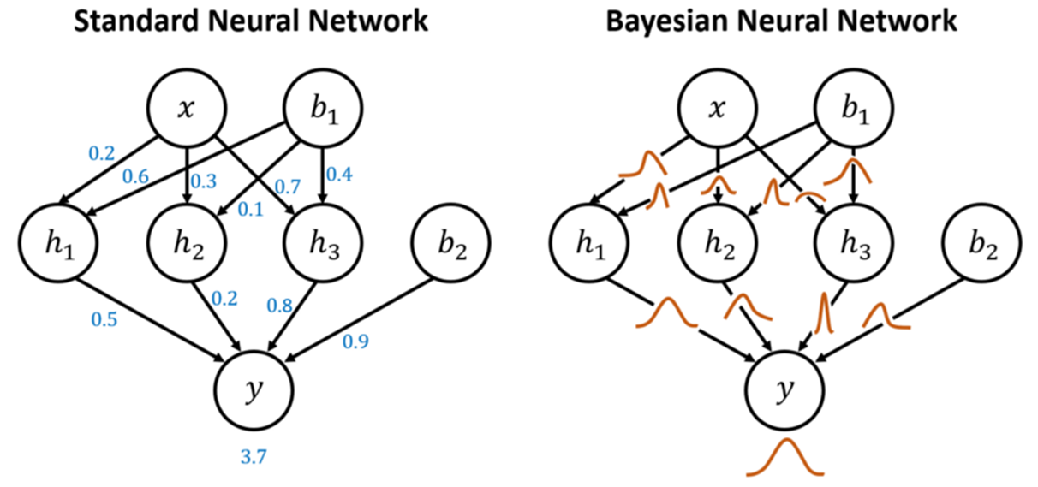
The Difference

Slide 8
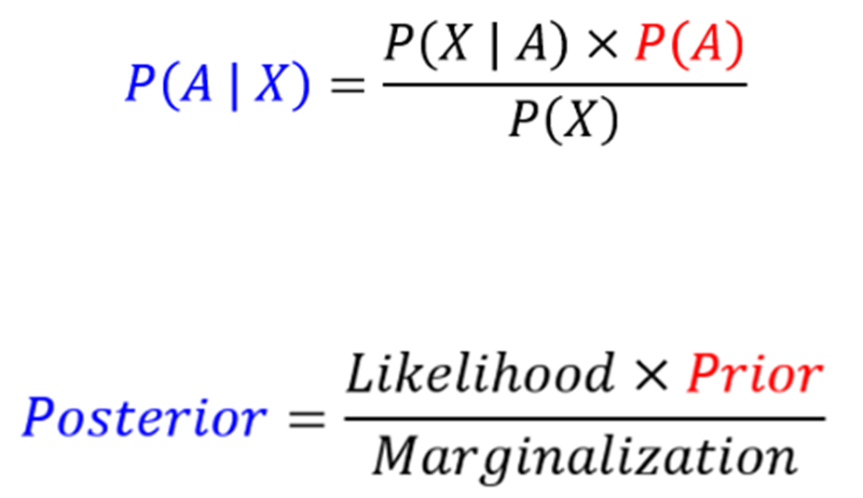
Starting with Bayes’ Theorem
Prior Probability (Prior): Belief prior to additional evidence
Posterior Probability (Posterior): Belief after considering additional evidence
https://blog.cyda.hk/2021/10/8-terms-you-should-know-about-bayesian.html

Slide 9
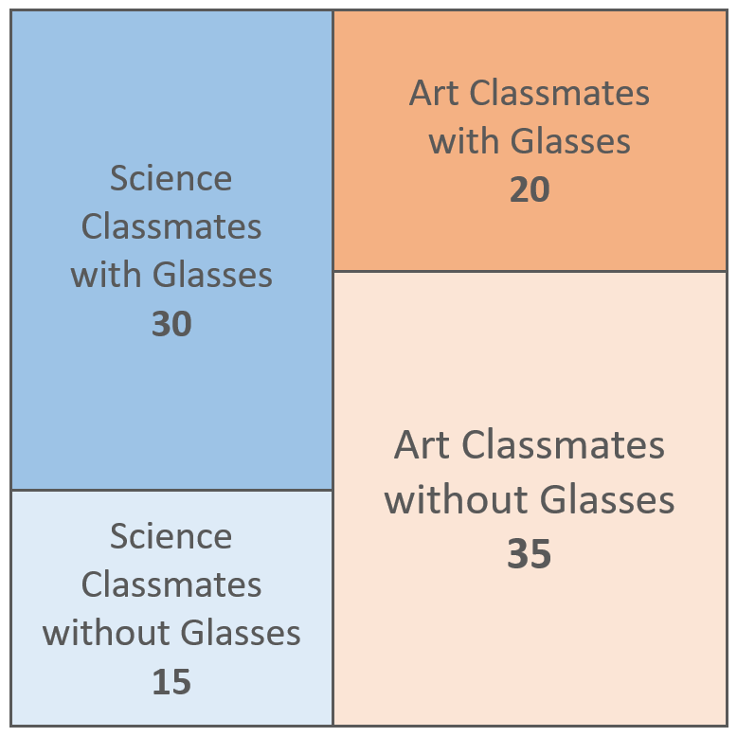
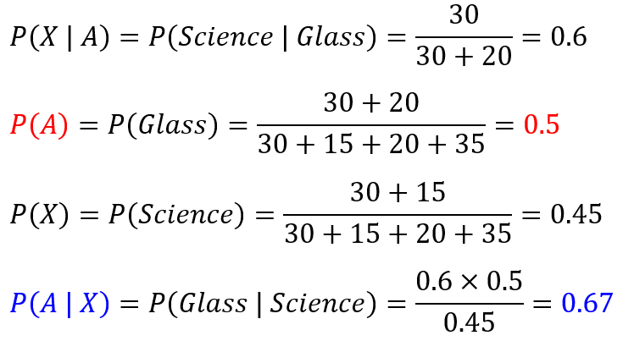
Bayes’ Theorem Example

Slide 10
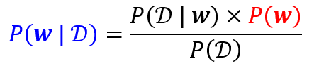

Bayesian Neural Networks
Prior: What distribution should your weights initially be drawn from?
Gaussian Priors are most common
Posterior: What is the true joint distribution that the weights should be drawn from?

Slide 11
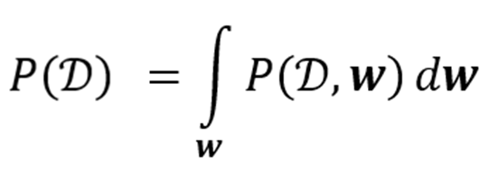
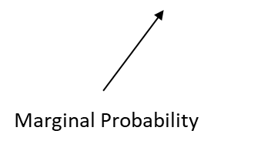
So Far So Good, But…
I need to determine the marginal probabilities
Closed-form of integral is nearly impossible
Makes calculating the posterior impossible
Due to computational complexity, we must adjust weights and approximate the posterior
Iterative process to help us find ideal distributions
Multiple methods to do so

Slide 12
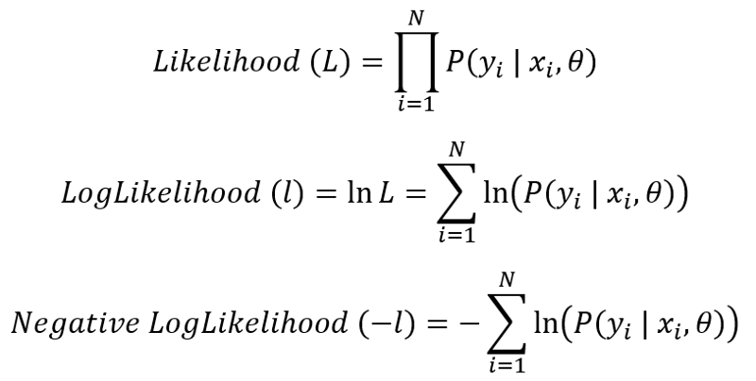
New Loss Function
We need to understand the likelihood of our weights and our data

Slide 13
How Does This Work?
Utilize Kullback-Leibler Divergence
Score difference between approximated distribution and posterior distribution
But wait- we don’t have the posterior!
Utilize our log evidence to work around it

Slide 14
Approximation Techniques
Variational Inference (VI)
Identify and tweak approximation of posterior
Markov Chain Monte Carlo (MCMC)
Use chain of states to represent posterior
Difficult to scale for size of BNN
Bayes by Backprop
Like VI, creates a parametric distribution which allows gradient analysis

Slide 15
Pros and Cons
Pros
Uncertainty Quantification
Robust Models
More “applicable”
Fights Overfitting
Cons
My brain hurts
“Requires advanced knowledge”
Needs more data
Tough to find convergence
Takes more time!

Slide 16
BNN Advancements
Probabilistic BNN
Predict gaussian parameters for individual response
Bayesian CNN
Focuses on reducing risk of overfitting
Bayesian GAN
Reduces risk of mode-collapse

Slide 17
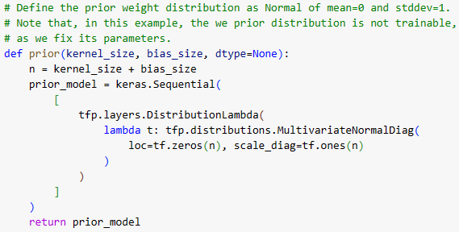
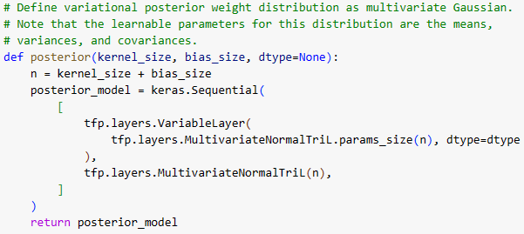
BNN in Practice
Create Priors
Create Posteriors

Slide 18
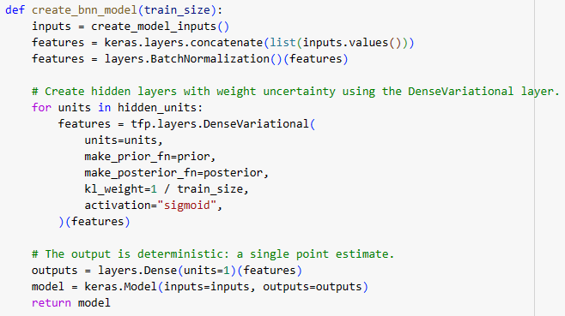
Create the BNN
Use a tfp.layers.DenseVariational layer instead of keras.layers.Dense
The epistemic uncertainty can be reduced as we increase the size of the training data. That is, the more data the BNN model sees, the more it is certain about its estimates for the weights (distribution parameters)
The result is a point estimate. We want to do more and get a distribution as the output

Slide 19
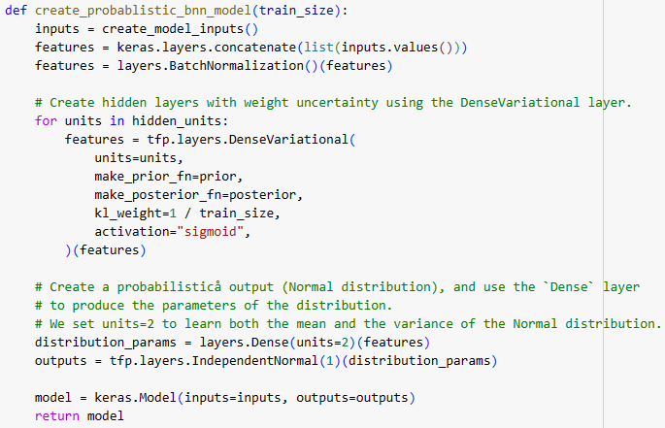
Probabilistic Bayesian Neural Network
In this example, we model the output as an `IndependentNormal` distribution with learnable mean and variance parameters
If the task were classification, we would have used `IndependentBernoulli` with binary classes, and `OneHotCategorical` with multiple classes, to model distribution of the model output

Slide 20
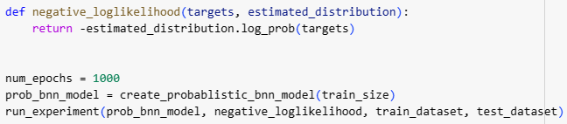
Loss Function
Since the output of the model is a distribution, rather than a point estimate, we use the negative loglikelihood as our loss function to compute how likely to see the true data (targets) from the estimated distribution produced by the model

Slide 21
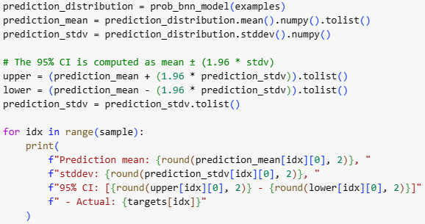
Output
Now let's produce an output from the model given the test examples. The output is now a distribution, and we can use its mean and variance to compute the confidence intervals (CI) of the prediction.

Slide 22

Questions?

Slide 23
Questions

